Slide 1
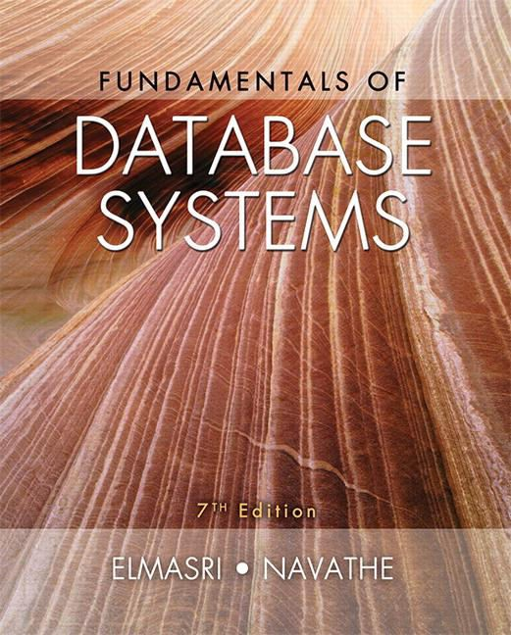
Copyright © 2016 Ramez Elmasri and Shamkant B. Navathe

Slide 2
CHAPTER 4
Enhanced Entity-Relationship (EER) Modeling

Slide 3
Introduction
EER stands for Enhanced ER or Extended ER
EER Model Concepts
Includes all modeling concepts of basic ER
Additional concepts:
subclasses/superclasses
specialization/generalization
categories (UNION types)
attribute and relationship inheritance
Constraints on Specialization/Generalization
The additional EER concepts are used to model
applications more completely and more accurately
EER includes some object-oriented concepts, such as inheritance

Slide 4
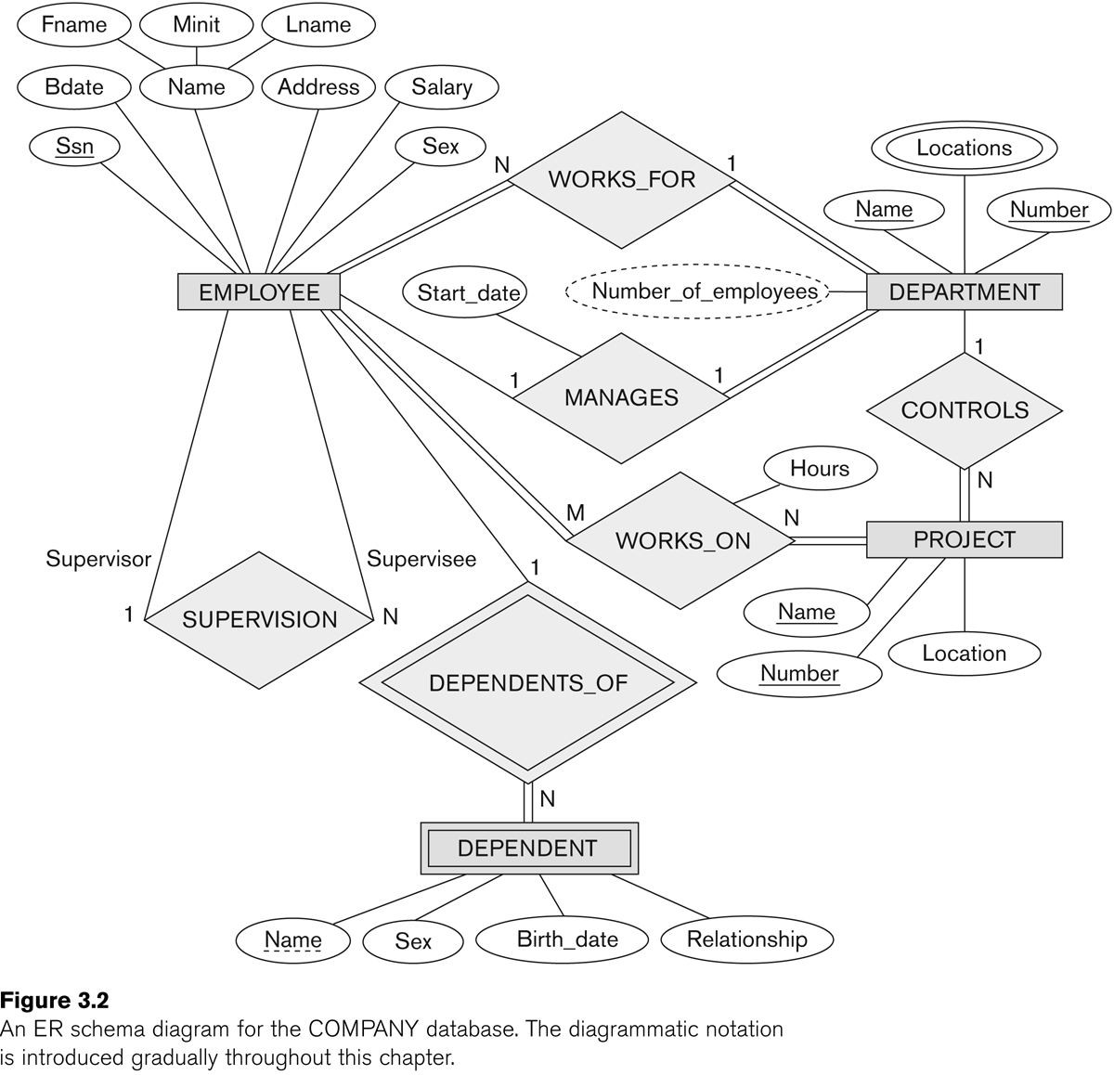
ER DIAGRAM

Slide 5
Subclasses and Superclasses (1)
An entity type may have additional meaningful subgroupings of its entities
Example: EMPLOYEE may be further grouped into:
SECRETARY, ENGINEER, TECHNICIAN, …
Based on the EMPLOYEE’s Job
MANAGER
EMPLOYEEs who are managers (the role they play)
SALARIED_EMPLOYEE, HOURLY_EMPLOYEE
Based on the EMPLOYEE’s method of pay
EER diagrams extend ER diagrams to represent these additional subgroupings, called subclasses or subtypes

Slide 6
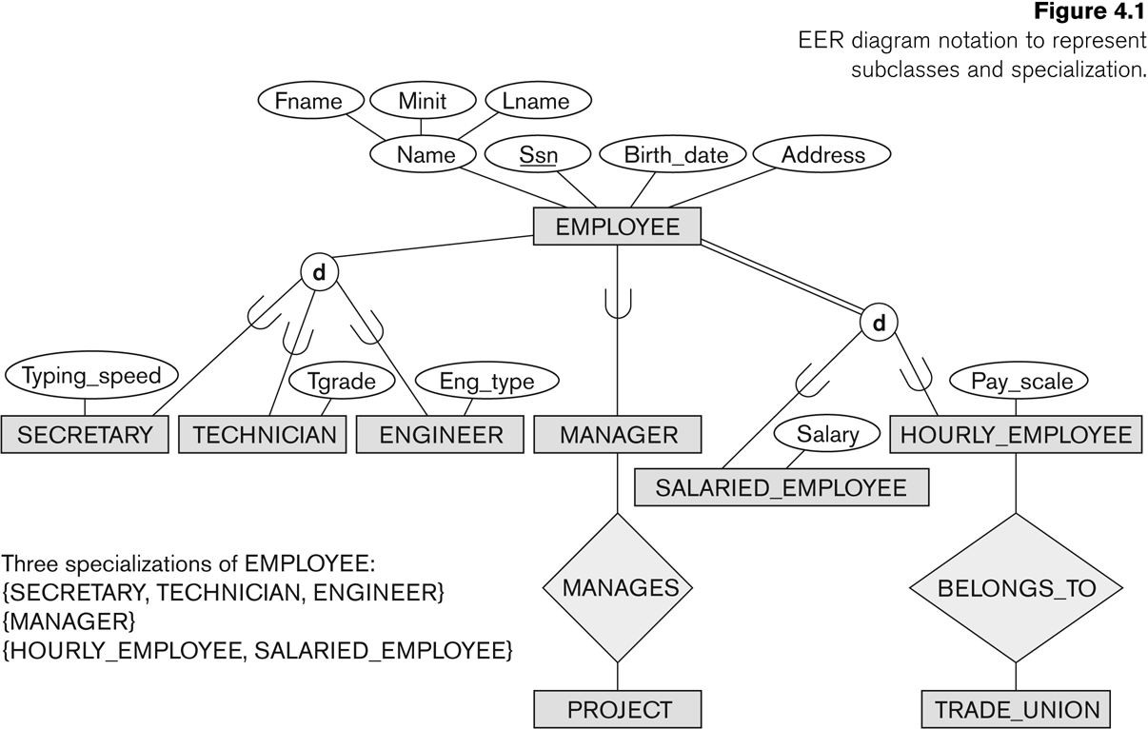
Subclasses and Superclasses

Slide 7
Subclasses and Superclasses (2)
Each of these subgroupings is a subset of EMPLOYEE entities
Each is called a subclass of EMPLOYEE
EMPLOYEE is the superclass for each of these subclasses
These are called superclass/subclass relationships:
EMPLOYEE/SECRETARY
EMPLOYEE/TECHNICIAN
EMPLOYEE/MANAGER
…

Slide 8
Subclasses and Superclasses (3)
These are also called IS-A relationships
SECRETARY IS-A EMPLOYEE, TECHNICIAN IS-A
EMPLOYEE, ….
Note: An entity that is member of a subclass represents the same real-world entity as some member of the superclass:
The subclass member is the same entity in a distinct specific role
An entity cannot exist in the database merely by being a member of a subclass; it must also be a member of the superclass
A member of the superclass can be optionally included as a member of any number of its subclasses

Slide 9
Subclasses and Superclasses (4)
Examples:
A salaried employee who is also an engineer belongs to the two subclasses:
ENGINEER, and
SALARIED_EMPLOYEE
A salaried employee who is also an engineering manager belongs to the three subclasses:
MANAGER,
ENGINEER, and
SALARIED_EMPLOYEE
It is not necessary that every entity in a superclass be a member of some subclass

Slide 10
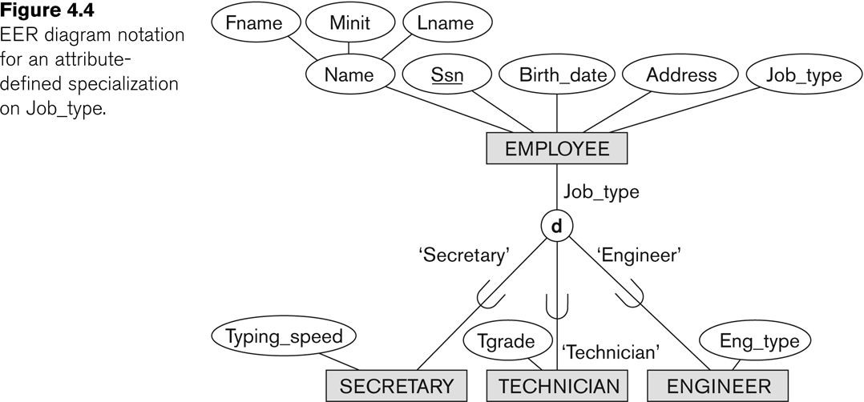
Representing Specialization in EER Diagrams

Slide 11
Attribute Inheritance in Superclass / Subclass Relationships
An entity that is member of a subclass inherits
All attributes of the entity as a member of the superclass
All relationships of the entity as a member of the superclass
Example:
In the previous slide, SECRETARY (as well as TECHNICIAN and ENGINEER) inherit the attributes Name, SSN, …, from EMPLOYEE
Every SECRETARY entity will have values for the inherited attributes

Slide 12
Specialization (1)
Specialization is the process of defining a set of subclasses of a superclass
The set of subclasses is based upon some distinguishing characteristics of the entities in the superclass
Example: {SECRETARY, ENGINEER, TECHNICIAN} is a specialization of EMPLOYEE based upon job type.
Example: MANAGER is a specialization of EMPLOYEE based on the role the employee plays
May have several specializations of the same
superclass
Copyright © 2016 Ramez Elmasri and Shamkant B. Navathe
Slide 4- 11
Notes:
Section 2 + 4

Slide 13
Specialization (2)
Example: Another specialization of EMPLOYEE based on method of pay is {SALARIED_EMPLOYEE, HOURLY_EMPLOYEE}.
Superclass/subclass relationships and specialization can be
diagrammatically represented in EER diagrams
Attributes of a subclass are called specific or local
attributes.
For example, the attribute TypingSpeed of SECRETARY
The subclass can also participate in specific relationship
types.
For example, a relationship BELONGS_TO of HOURLY_EMPLOYEE

Slide 14
Specialization (3)

Slide 15
Generalization
Generalization is the reverse of the specialization process
Several classes with common features are generalized into a superclass;
original classes become its subclasses
Example: CAR, TRUCK generalized into VEHICLE;
both CAR, TRUCK become subclasses of the superclass VEHICLE.
We can view {CAR, TRUCK} as a specialization of VEHICLE
Alternatively, we can view VEHICLE as a generalization of CAR and TRUCK

Slide 16
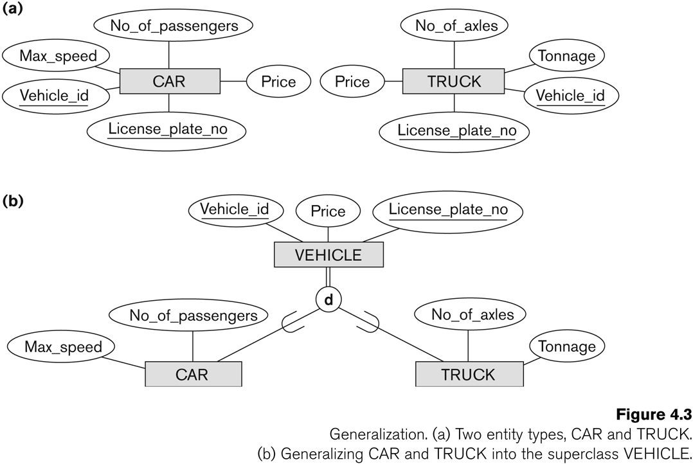
Generalization (2)

Slide 17
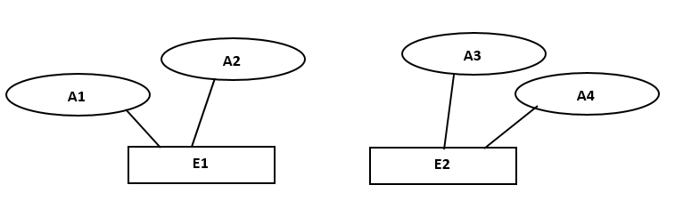
Generalization (3)
?????

Slide 18
Types of Specialization
Predicate-defined ( or condition-defined) : based on some predicate. E.g., based on value of an attribute, say, Job-type, or Age.
Attribute-defined: shows the name of the attribute next to the line drawn from the superclass toward the subclasses (see Fig. 4.1)
User-defined: membership is defined by the user on an entity by entity basis
Notes:
Fig. 4.1 ---→ Slide 14

Slide 19
Constraints on Specialization and Generalization (1)
If we can determine exactly those entities that will become members of each subclass by a condition, the subclasses are called predicate- defined (or condition-defined) subclasses
Condition is a constraint that determines subclass members
Display a predicate-defined subclass by writing the predicate condition next to the line attaching the subclass to its superclass

Slide 20
Constraints on Specialization and Generalization (2)
If all subclasses in a specialization have membership condition on same attribute of the superclass, specialization is called an attribute-defined specialization
Attribute is called the defining attribute of the specialization
Example: JobType is the defining attribute of the specialization {SECRETARY, TECHNICIAN, ENGINEER} of EMPLOYEE
If no condition determines membership, the subclass is called user-defined
Membership in a subclass is determined by the database users by applying an operation to add an entity to the subclass
Membership in the subclass is specified individually for each entity in the superclass by the user

Slide 21
Displaying an attribute-defined specialization in EER diagrams

Slide 22
Constraints on Specialization and Generalization (3)
Two basic constraints can apply to a specialization/generalization:
Disjointness Constraint:
Completeness Constraint:

Slide 23
Constraints on Specialization and Generalization (4)
Disjointness Constraint:
Specifies that the subclasses of the specialization must be disjoint:
an entity can be a member of at most one of the subclasses of the specialization
Specified by d in EER diagram
If not disjoint, specialization is overlapping:
that is the same entity may be a member of more than one subclass of the specialization
Specified by o in EER diagram

Slide 24
Constraints on Specialization and Generalization (5)
Completeness (Exhaustiveness) Constraint:
Total specifies that every entity in the superclass must be a member of some subclass in the specialization/generalization
Shown in EER diagrams by a double line
Partial allows an entity not to belong to any of the subclasses
Shown in EER diagrams by a single line

Slide 25
Constraints on Specialization and Generalization (6)
Hence, we have four types of specialization/generalization:
Disjoint, total
Disjoint, partial
Overlapping, total
Overlapping, partial
Note: Generalization usually is total because the superclass is derived from the subclasses.

Slide 26
Example of disjoint partial Specialization

Slide 27
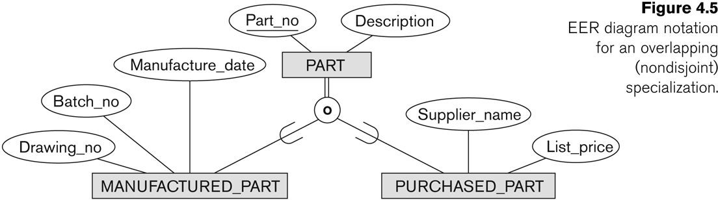
Example of overlapping total Specialization

Slide 28
Specialization/Generalization Hierarchies, Lattices & Shared Subclasses (1)
A subclass may itself have further subclasses specified on it
forms a hierarchy or a lattice
Hierarchy has a constraint that every subclass has only one superclass (called single inheritance); this is basically a tree structure
In a lattice, a subclass can be subclass of more than one superclass (called multiple inheritance)

Slide 29
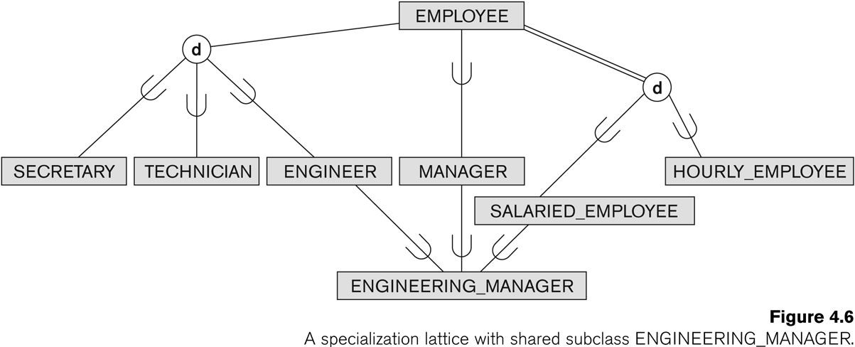
Shared Subclass “Engineering_Manager”

Slide 30
Specialization/Generalization Hierarchies, Lattices & Shared Subclasses (2)
In a lattice or hierarchy, a subclass inherits attributes not only of its direct superclass, but also of all its predecessor superclasses
A subclass with more than one superclass is called a shared subclass (multiple inheritance)
Can have:
specialization hierarchies or lattices, or
generalization hierarchies or lattices,
depending on how they were derived
We just use specialization (to stand for the end result of either specialization or generalization)

Slide 31
Specialization/Generalization Hierarchies, Lattices & Shared Subclasses (3)
In specialization, start with an entity type and then define subclasses of the entity type by successive specialization
called a top down conceptual refinement process
In generalization, start with many entity types and generalize those that have common properties
Called a bottom up conceptual synthesis process
In practice, a combination of both processes is usually employed

Slide 32
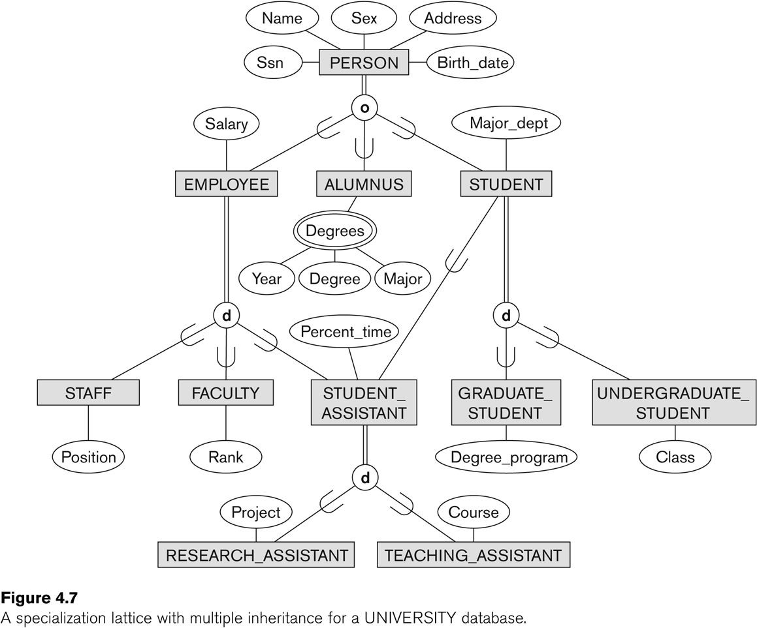
Specialization / Generalization Lattice Example (UNIVERSITY)
# of Attributes of Employee:
# of Attributes of Staff:
# of Attributes of Student_Assistance:
# of composite attribute:
# of complex attribute:
# of multivalued attribute:
Shared subclass:
Disjoint, total specialization example:
Disjoint, partial specialization example:
Overlapping, total specialization example:
Overlapping, partial specialization example:
Hierarchy example:
Lattice example:

Slide 33
Summary
Introduced the EER model concepts
Class/subclass relationships
Specialization and generalization
Inheritance
Constraints on EER schemas
These augment the basic ER model concepts introduced in Chapter 3
EER diagrams and alternative notations were presented

